Slide 1
MARKET BASKET ANALYSIS
BY-LOKESH SINGH

Slide 2
HOOK STORY
"Unlocking the Secrets of Your Shopping Cart: How Everyday Purchases Reveal Hidden Patterns!"
In this story, we dive into the fascinating world of market basket analysis—a powerful data mining technique that helps retailers understand their customers' buying habits. By examining what products are frequently purchased together, retailers can optimize their store layouts, create targeted promotions, and ultimately boost sales. We'll explore real-life examples of how companies like Amazon, Walmart, and Tesco use market basket analysis to predict customer preferences and enhance the shopping experience. Get ready to discover how your weekly grocery run holds the key to powerful insights and strategic business decisions."

Slide 3
PRESENTATION FLOW
INTRODUCTION
DATA COLLECTION
DESCRIBE DATASET
DATA PREPROCESSING
MODELLING IMPLEMENTATION
MODEL EVALUATION
REULTS SND CONCLUSION
FUTURE SCOPE
REFERENCES

Slide 4
INTRODUCTION
Market basket analysis is a data mining technique retailers use to increase sales by better understanding customer purchasing patterns. Analyzing large data sets, such as purchase history, reveals product groupings and products likely to be purchased together.

Slide 5
MBA IN RETAIL SCENARIO
Each customer purchases different sets products,different quantities,different times.
MBA Uses this information to-
Customer identification
Understand why they make certain purchase
Gain insights about its product(fast & slow mover)
Product which are purchased together

Slide 6
ALGORITHMS USED IN MARKET BASKET ANALYSIS

Slide 7
APRIORI ALGORITHM
The Apriori algorithm is the most common technique for performing market basket analysis.
It is used for association rule mining, which is a rule-based process used to identify correlations between items purchased by users.
Most store customers have purchased yogurt, vinegar, and bear together. Therefore, {yogurt,vinegar,bear} is a frequent itemset as it appears in most purchases. So, if a person grabs bear and vinegar, they will also be recommended yogurt
According to the Apriori algorithm, a subset of the frequent itemset is also frequent. Since {yogurt,vinegar,bear}is a frequent itemset, this means that {vinegar,bear}, {yogurt,vinegar}, and {yogurt,bear} are also frequent. Due to this, if a customer only goes for yogurt, they will be recommended both bear and vinefar as well.

Slide 8
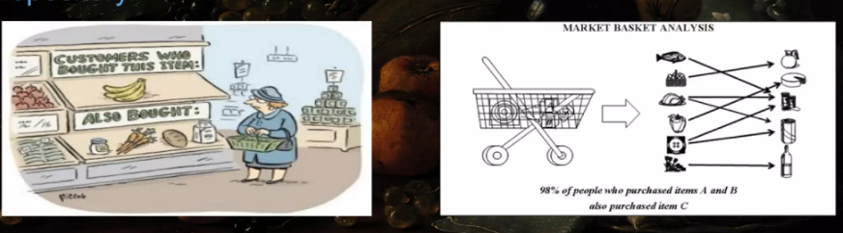
ASSOCIATION RULE
Association rules are if/then statements that help uncover a relationships between seemingly unrelated data in atransactional database,relational databse or other information repository.

Slide 9
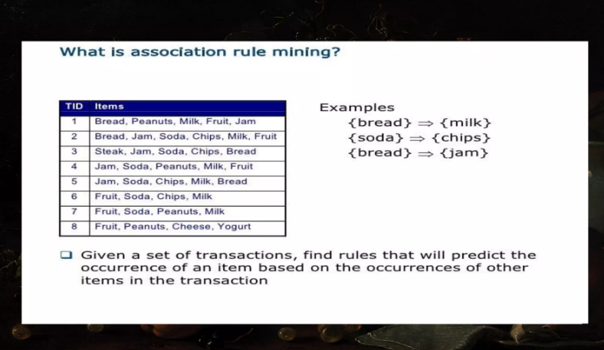

Slide 10

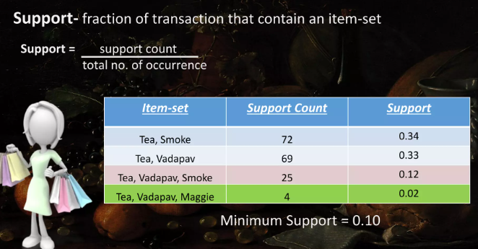
The Components of the Apriori Algorithm are:
SUPPORT
It tells us about the combination of items bought together frequently. It gives the part of transactions that contain both A and B.
We can filter out the less frequently occurring items-sets using support.

Slide 11


CONFIDENCE
It tells us how frequently the items A and B are bought together, for the no. of times A is bought.
LIFT
Measure of confidence of combination as per the support of one item.

Slide 12
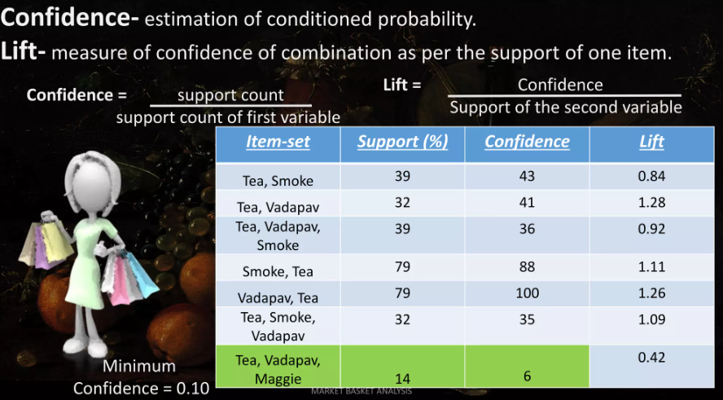

Slide 13
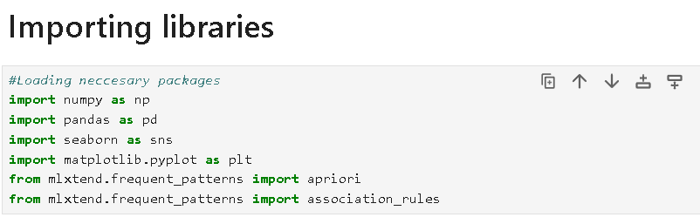
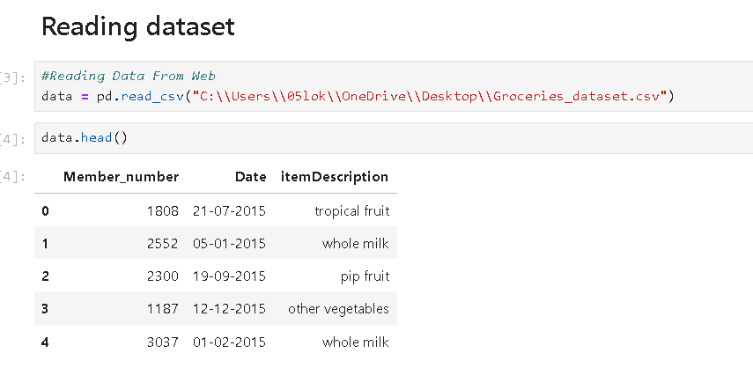
DATA COLLECTION

Slide 14
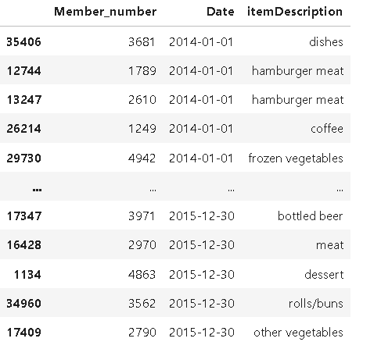
DESCRIBE DATASET
THERE ARE TOTAL
ROWS-38006
COLUMNS-3

Slide 15
DATA PREPROCESSING-
The process of cleaning and transforming raw data so that it can be more easily analzed understand and used in machine learning models.
goal-To improve data quality.
steps-1. removing incorrect values
2. handling missing values

Slide 16
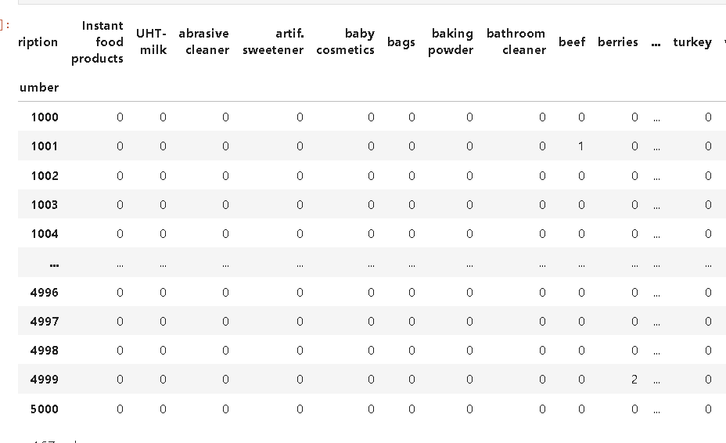
Removing missing value to 0

Slide 17
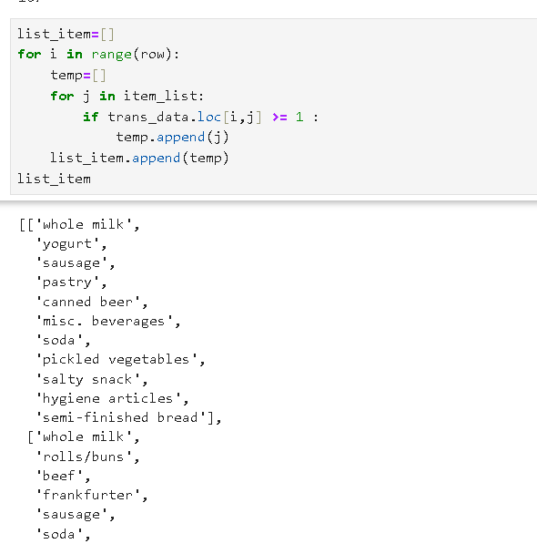
Converting into list of item

Slide 18
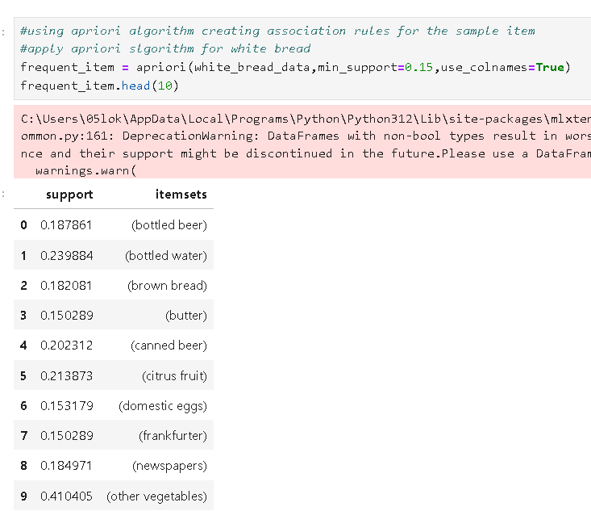
Model implementation & evaluation

Slide 19
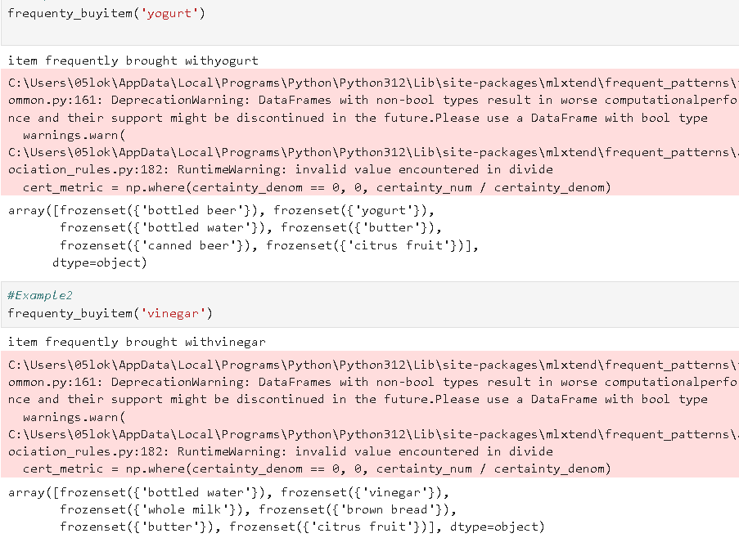
result:

Slide 20
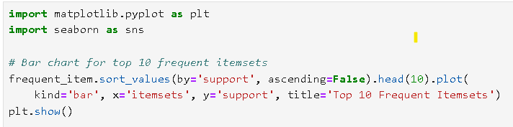
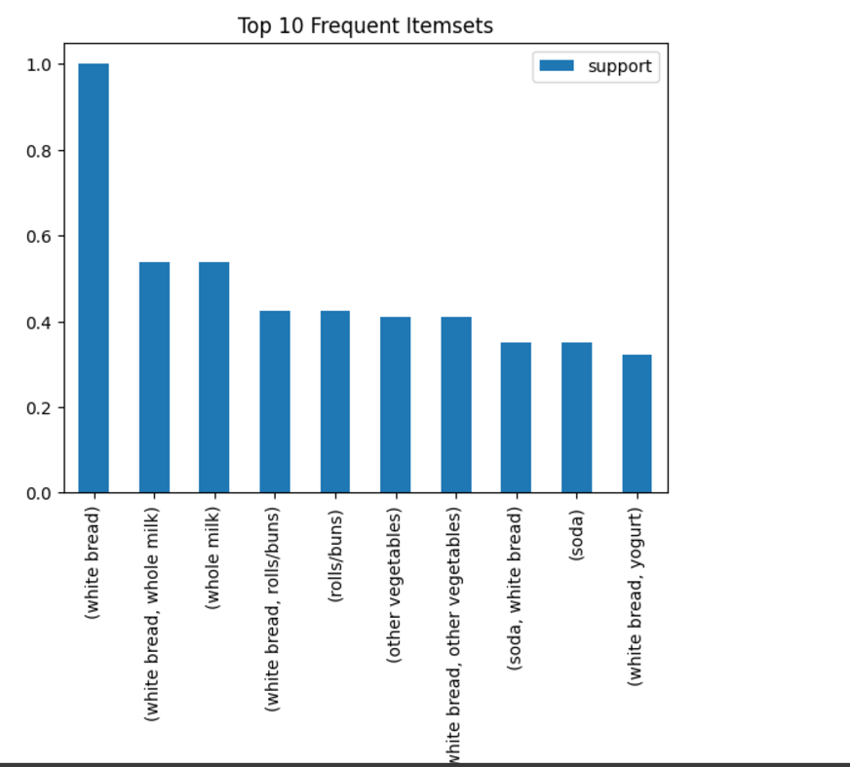
some data visualization

Slide 21
FUTURE SCOPE
Dynamic User Behavior Analysis: As user data becomes more personalized, future versions of Apriori could focus on adaptive learning. These versions could generate dynamic association rules that evolve over time based on changing user preferences or environmental factors.
Recommendation Systems: Apriori can be further applied to recommender systems, where it not only looks for frequent co-occurrence but also adapts to individual user behavior, offering personalized suggestions for products, content, or services.
Supply Chain & Manufacturing: Apriori can help optimize supply chains by identifying frequent item associations in logistics data, leading to more efficient inventory management and predictive maintenance.

Slide 22
REFRENCES
https://github.com/GulzarAhmedButt/Market-Basket-Analysis
https://www.kaggle.com/datasets/irfanasrullah/groceries

Slide 23
Thanks

